Slide 1
Summer Internship Program Presentation: LoRaWAN Temperature Sensors for the City of Melville
February 2018
Notes:
Hi my name is Jack Downes.
I’ve developed a tool to more effectively capture heat data for the City of Melville.
Before I go on to introduce the solution, I’d like to explain the relationship between local government and mapping heat.

Slide 2
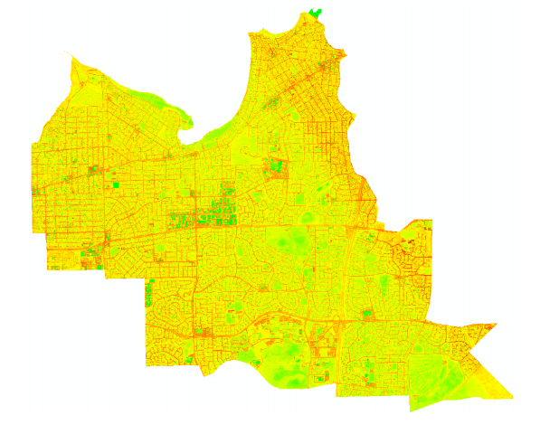
Heat Islands & Urban Forests
(Dave Schupp)
Notes:
The City of Melville are tasked with balancing the affects of Heat Islands and Urban Forests.
Heat Islands represent metropolitan areas which are significantly warmer due to energy retained in man made materials.
This can be combatted by Urban Forests, which are areas of vegetation that can act to cool ambient air temperatures along with a host of other benefits.
You can see clearly in this thermal satellite image of Melville the interaction between the two environments, the higher temperature road network shown red weaving around the lower temperature forested parks and reserves shown in green.
As metropolitan living becomes more dense finding the balance is a question of mitigating the affect of heat islands and fully utilizing the cooling power of urban forests.

Slide 3
Problem overview
How far apart should trees be planted?
What types of Asphalt dissipate heat fasted?
Can the colour of roofs in the area have an affect the amount of heat it retains?
Does a row of trees running East West become more affective than one running North South?
Notes:
Shown on the screen is a non-extensive list of issues faced by Local government when making these design choices.
At the moment these questions are answered using limited and costly thermal imagery, manual labour or simply best judgement.
For my Summer internship with ICP I’ve been looking into a way to help decision makers make evidence based choices.

Slide 4
The Requirements
Data
Flexibility
Cost
Notes:
To do this we arrived at a solution that would:
1. Provide Data that is more localised and accountable
2. Cost a fraction of the price of thermal imagery
3. Provide the flexibility to scale and adapt to project requirements

Slide 5
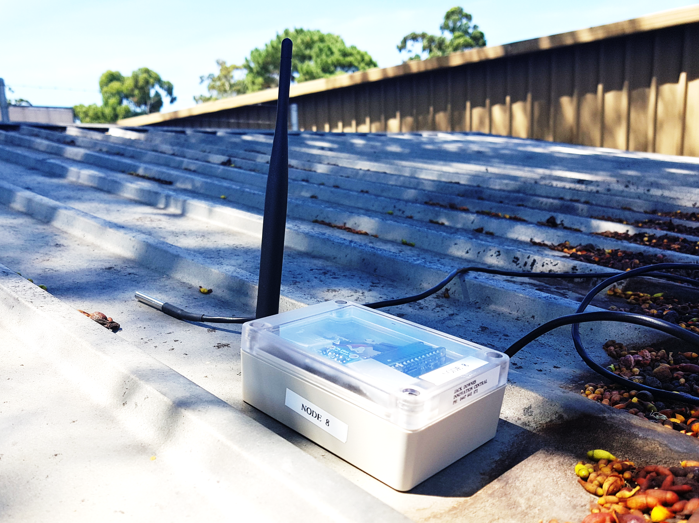
Solution
Notes:
I give you the solution. A LoRaWAN enabled battery powered sensor array. The LoRaWAN network is a protocol just like WIFI but designed for low power consumption and long range transmission. A perfect tool for this project.
Boasting recording intervals as regular as 60 seconds, a battery life that can endure for weeks and sharp good looks. The LoRaWAN Temperature Sensor provides an elegant solution to an array of questions.

Slide 6
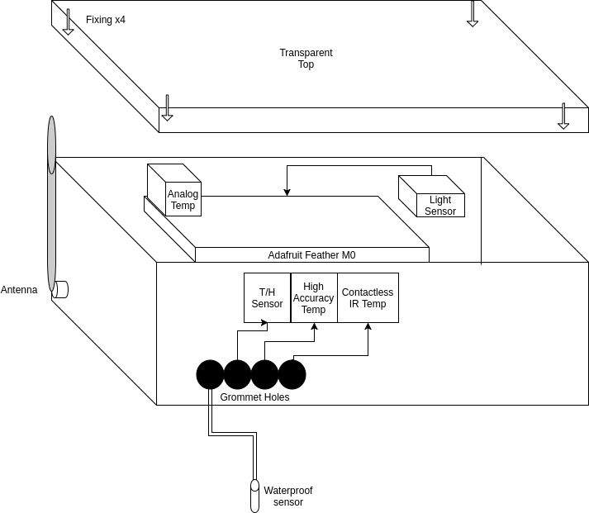
Sensor Design
Notes:
The beauty of this solution compared to others is it’s low cost, versatility and scalability.
The total component cost for a sensor unit is around $60 and can be built in an hour.
The unit include a light sensor for tracking real time exposure to sun light, and an external temperature sensor that can read the ambient air temperature above a surface of interest to the nearest half a degree.
Any amount of low power sensors can be added to the system to record things like moisture levels, humidity and even location (for those sensors that have a tendency to leave the job).

Slide 7
The System
Sensor
LoRaWAN Gateway
Database Server
Client Application
Notes:
The system is not just a thermometer and a sun switch. It’s also what’s behind the scenes that allows the data to be collected, kept in an orderly fashion and interpreted for what ever the researcher is interested in.

Slide 8
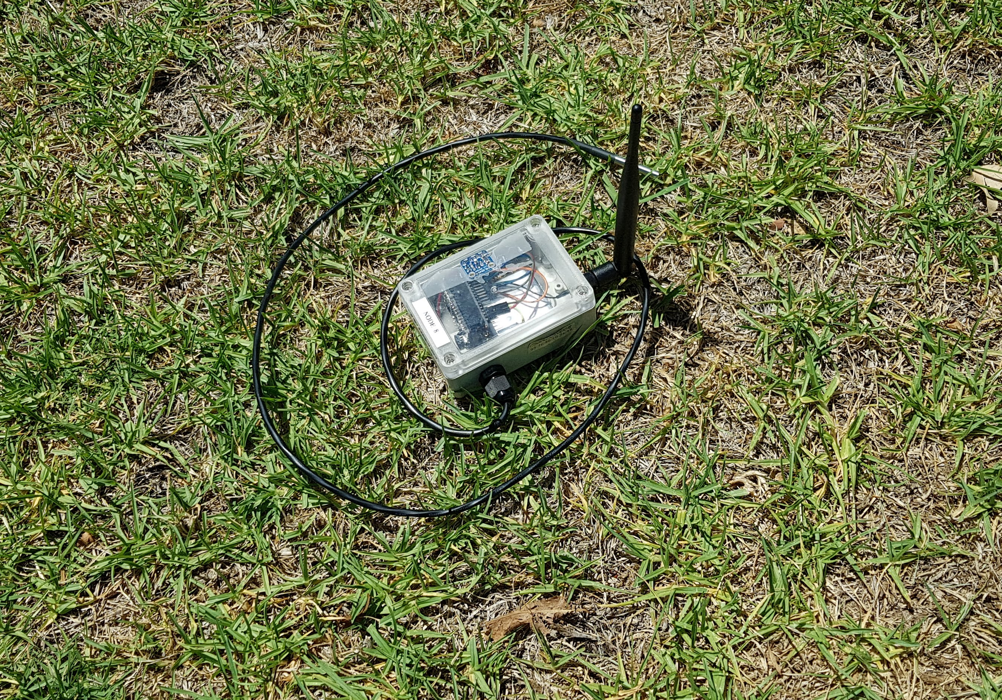
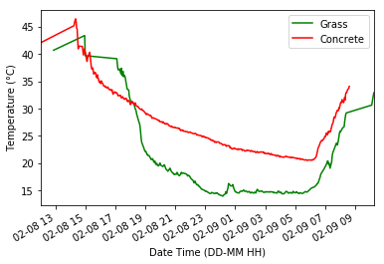
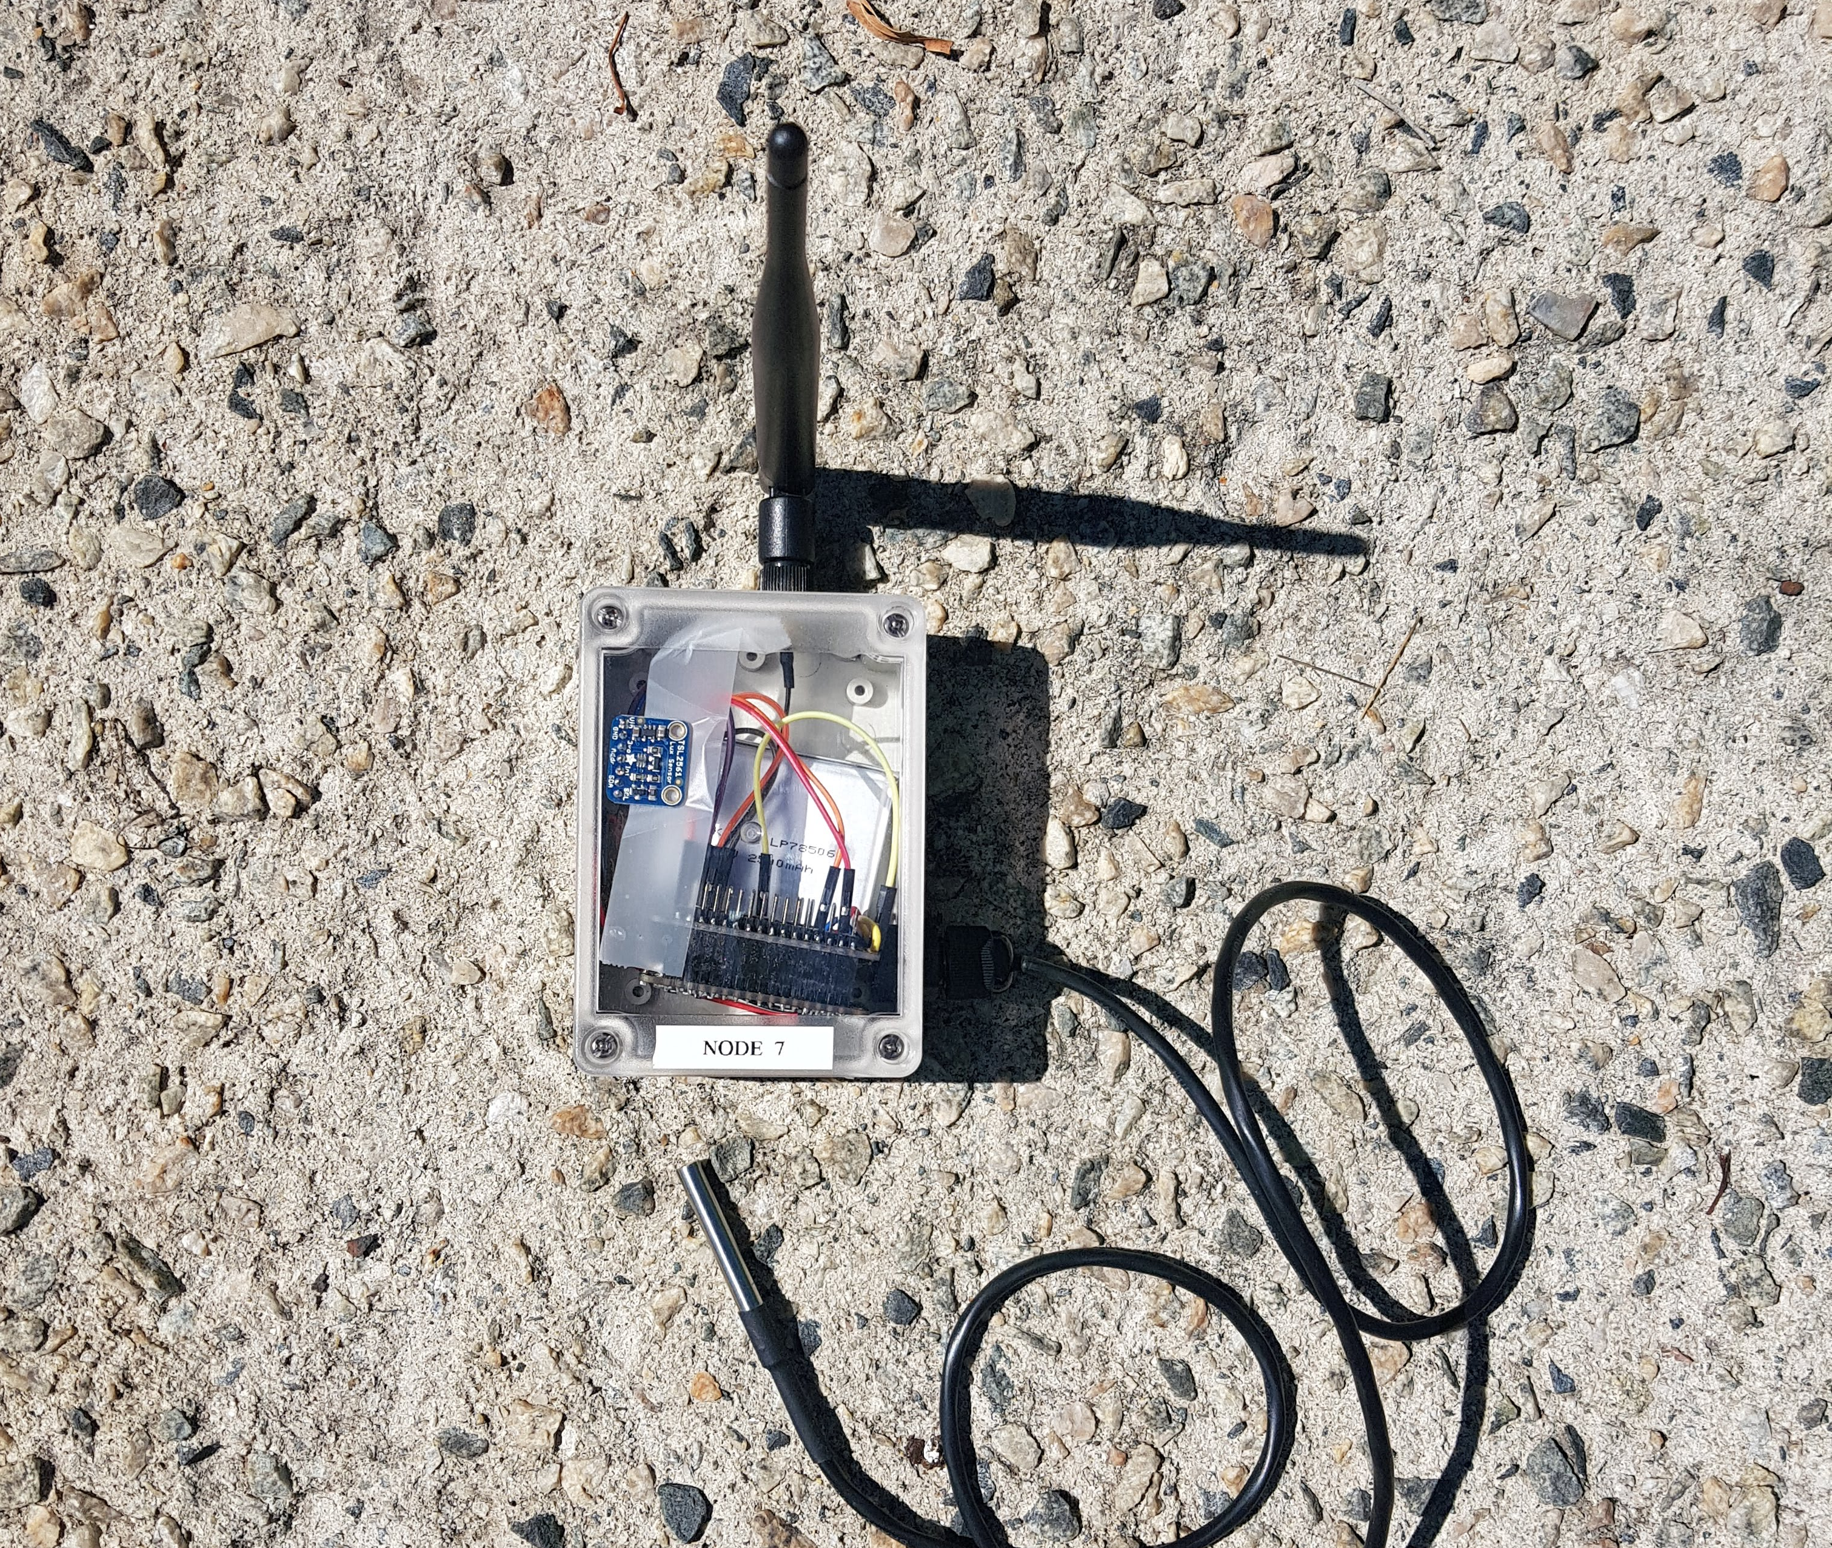
Overnight Heat Dissipation
Notes:
Here’s an example of how the unit can be deployed.
Two sensors were deployed overnight, one on a grassy field another on light coloured concrete.
Overnight the sensors fed ambient temperature information back to the database at two minute intervals.
Plotting this data side by side you can see the difference in how the materials handle heat dissipation despite being 200m apart.

Slide 9
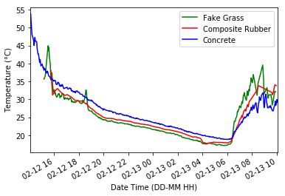
Playground Materials
Notes:
Here 3 alternative materials for playground design can be plotted side by side.

Slide 10
In Conclusion
Notes:
//This project was an opportunity for me to scope out and plan a project with a heap of moving parts
++talk about how it can be used by many councils and solve other similar issues

Slide 11
Acknowledgements
Nathan jombwe
Petra Helmholz
David Belton
Janine Ahola
Iman
Tom
Kevin Glasson
Antoni Liang

Slide 12
References
Urban Forest Canopy Coverage and its Effect on Heat Islands in the City of Melville Bradley Dave Schupp

